Slide 1

Aegis Consulting Services

Slide 2


Introduction
About Us
Our Vision & Mission
Our Clients
> AP Agriculture Department
> TS Agriculture Department
> APCOB
> TSCAB
> HFCL
> C-Vision
> C & DMA - AP

Slide 3
About Us
Aegis Consulting Services is a software engineering and development company in the area of providing information technology based solutions to various business entities operating in different segments.
The company applies robust and optimal methodologies; state of art techniques with software engineering skills to domain knowledge in creating information technology based solutions of clients in their respective domains.
Aegis Consulting Services keeps abreast with the state of art techniques. Knowledge of the technologies are carefully analyzed for suitability and appropriately deployed with the solution. The company has in-depth domain as well as functional knowledge.

Slide 4
Our Vision & Mission
Aegis's Vision
To create a cohesive group of technology creative talent, which holds the capacity to deliver effective results while deploying optional resources.
Aegis's Mission
To be globally recognized as a provider of a trusted, reliable resource to quality Information Technology (IT) solutions. To build worldwide partnerships for success. To give the clients a competitive edge. To enhance the operational efficiency and financial advantage to clients.

Slide 5
Projects Executed
Govt. of Andhra Pradesh
Projects - Web
> Online License Management System (OLMS)
> Mee Seva Integration of OLMS
> Vaddi Leni Panta Runalu
> Agri Services – CM Dash Board
> Soil Health Management System
> Fertilizer Monitoring System
> Polam Pilusthondi
> Pest Information
> Input Subsidy
> Chandranna Rythu Kshetram
> Seed Distribution

Slide 6
Projects Executed
Govt. of Andhra Pradesh
Projects - Android
> Soil Health Management System
> Polam Pilusthondi
> Chandranna Rythu Kshetram
C&DMA
Projects – Web
> Project Management Tool
– Web & Android
> Online Survey (Praja Prathispandana)
> Property Assessment
> Feed Back Survey
APCOB
Projects > Farmer Information Management System

Slide 7
Projects Executed
TSCAB
Projects > Farmer Information Management System
HFCL
Projects > ERP
> Arrears Calculation
C-VISION > Talent Acquisition portal
Web Site Design & Developments
Projects > http://www.willisrx.com
> http://www.towersrx.com
> http://global-it-inc.com
> http://my3tech.com
> http://eastrx.com
> http://kisanonline.in
> http://teknvent.com

Slide 8
GROWTH APPROACH
We are very focused to propose the Integrated Agriculture Management solution to all the states of India. Since the product evolved with day to day requirements of Government and Farmer over a period of 4 years we are confident to claim we understand business and technology integration in Agriculture.
There are desperate systems in many of the states but not an integrated dash board system either at CM level or Principal Secretary level for information on real time basis. Similarly, Farmers need information proactively to plan, procure, produce and sell.
From Centre to State, All the policies, procedures and projects are similar in nature. Only localization and grants will change.
Positioning the solution as a product or framework, custom develop and deploy. Revenue model will be “ Direct Procurement or Pay per Use”
Government of Andhra Pradesh has come up with E.Pragati Program which has 30% contribution from Aegis. Estimated 127Cr. We are in advanced stages of discussion with the Largest Software Company in India as vendor / contractor to execute this project.

Slide 9
PSPD Model
Quality
People
Transparency
Predictability
Sustainability
Maintenance
Translating clients to partners
Long-term relationship
Offshore Software Development Centers
Growth
Profitability
De-risking
Higher value services
Exposure limits for client concentration
Increase revenue productivity
Exposure limit for big data businesses
Offshore model - Global Delivery
Exposure limit for opportunity businesses (like e.pragati)
Upsell to existing customers
Iterative Model of Development
Geographical diversification

Slide 10

Moving-up the Value Chain – A Multi-pronged Approach
Expand and diversify
base of IT professionals
End-to-end service provider
Increase employee productivity by promoting reuse
Offer new services to existing clients
Use tools and methodologies
Develop
new clients

Slide 11
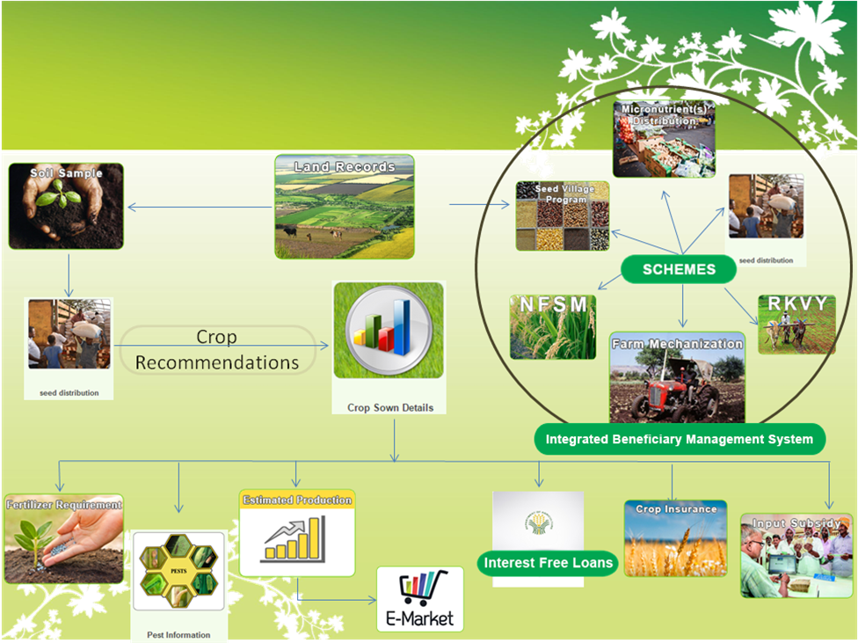
Inter-connecting all business process of agriculture and farmer : Evolved from experience

Slide 12
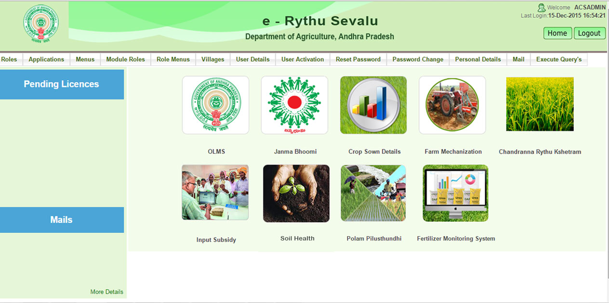

Slide 13
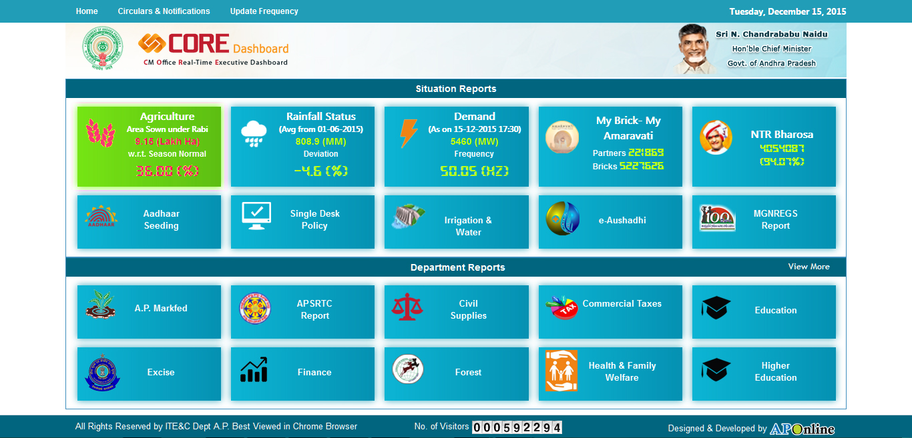

Slide 14
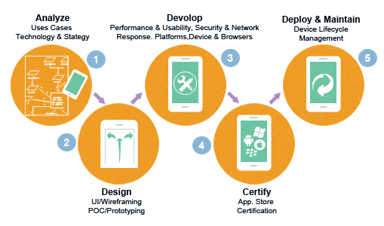
Technologies Adapted
Web
  JAVA 1.6 ,1.8
  JSF 1.2 ,2
  Ice faces 1.2 , 4
  Hybernate 3.0 ,4
  Mysql 5.1 ,5.5
  Spring 2.5 ,4.0.5
Mobile
  JAVA
  Android
  IDE – Android Studio

Slide 15
Online License Management System
The main objective of Online License Management System is to enable online submission of application for grant of new Authorization Letter for carrying seed, fertilizer, pesticide business. The application can also be used for renewal, amendment or issue of duplicate authorization letters. Automatic generation of Authorization letters is possible once it is approved by competent authority.
Technical Specifications:
Technology: Java 1.6, JSF 1.2, Spring 2.5, Hibernate 3.0, Ice faces 1.2, I Reports 3.7
Servers: Windows server 2003/2008
Database: MySQL 5.1.5
Highlights:
    Digital Signature Integration
    Payment Gateways
    Integration with Citizen Centres

Slide 16
Online License Management System
For accessing the Online License Management System of seeds, fertilizers, pesticides click on “eSevalu” link in Agriculture Department’s AGRISNET portal www.apagrisnet.gov.in Then click on “Eruvula license koraku darakhastu”. The application can also be accessed directly from the below link
  www.agrionline.ap.gov.in:8080/OLMS

Slide 17
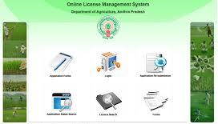

Online License Management System
Opportunity
Avoiding Paper – All applications should be accepted only through online.
All services can be accessed from a single place.
All licenses to be maintained online and should be able to access whenever required.
License Search option is provided
Site specific architecture.
Technologies Used
Java 1.6, JSF 1.2, Spring 2.5, Hibernate 3.0
Jboss 4.2.3 GA
MySQL 5.1.5
iReport 3.7.5, iText 2.0
Benefits
Applicant can apply for Seeds/Fertilizers/Pesticides license services from anywhere
All the department users(1600+) are connected through OLMS and perform their daily work online
Every license is applied, processed and generated online
Transparency is made to the applicant so that he can track the status of the application
CITIZEN CHARTER implementation which facilitates no delay in processing the application with SMS integration
Access to the applicants to apply for their respective license through Citizen Centers and can obtain license from the citizen centers

Slide 18
Vaddi Leni Panta Runalu
Description:
Interest Free Crop Loans is one of the schemes implemented to provide crop loans without interests to farmers by State Government of Andhra Pradesh.
The main aim of the application is to monitor the end to end process of the “VLR / Pavala Vaddi” Scheme implementation. The farmer wise data will be provided by each banker by submitting/uploading claims through the application. Interest amounts are calculated for each farmer through the Application and the claim amounts are disbursed to the corresponding Banks.
Technical Specifications:
Technology: Java 1.6, JSF 1.2, Spring 2.5, Hibernate 3.0, Ice faces 1.2, I Reports 3.7
Servers :Windows server 2003/2008
Database: Oracle 10g
Highlights:
  Automation of daily transaction of claims.
  Amounts are disbursed to beneficiaries at a single click
  End to End monitoring of Scheme across the state within a single window.

Slide 19
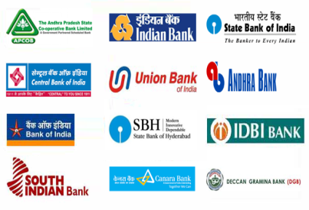

VLR-Crop Loan Interest Waiver
Opportunity
New beneficiary scheme to be implemented across the state
End to end tracking & monitoring of the scheme across the state.
Validating each beneficiary and disbursing the amounts directly to the beneficiary account.
Various reports to be generated at different levels.
Technologies Used
Java 1.6, JSF 1.2, Spring 2.5, Hibernate 3.0
Jboss 4.2.3 GA
Oracle 10g
Benefits
End to monitoring of the Scheme implementation across the state
Bankers can directly login to the website and upload the beneficiary details.
Beneficiary details are processed and amounts are disbursed to the beneficiary accounts directly.
MIS Reports can be generated at any instance.
Identification of duplicate beneficiaries

Slide 20
Agri Services – CM Dashboard
For Andhra Pradesh Chief Minister the state government has developed a web portal for integration of all the departments in the state for monitoring them online. We have provided the web services for the Agriculture Department services of Andhra Pradesh State for monitoring the End to End functioning of department.
Technical Specifications:
Technology: Java 1.6, JSF 1.2, Spring 2.5, Hibernate 3.0, Ice faces 1.2, I Reports 3.7
Servers: Windows server 2003/2008
Database: MySQL 5.1.5
Highlights:
  Pushing data from Database to the CM-Dashboard software through web service.
  Centralized Data warehouse
  Developed a portal for Agriculture Department for input of data collected.

Slide 21
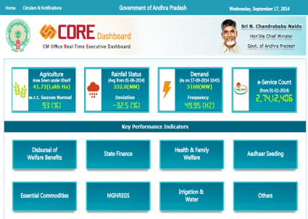
Agri Services – CM Dashboard
Opportunity
Chief Minister – Andhra Pradesh state initiative.
End to end tracking & monitoring of functioning of various departments across the state.
Identifying reportable data which requires immediate attention by the government.
To bring down all government departments at one place.
Technologies Used
Java 1.6, JSF 1.2, Spring 2.5, Hibernate 3.0, Ice faces 1.2, I Reports 3.7
Jboss 4.2.3 GA
MySQL 5.1.5
Benefits
End to end tracking & monitoring of functioning of Agriculture department across the state.
Day to day / timely updation of data from Agriculture department and showcasing it in various reports such as bar graphs, pic charts, line graphs etc..
Memos can be issued based on the daily status.
At a glance H’ble Chief Minister can focus and take measures or action based on their performance.

Slide 22

Soil Health Management System
Soil sampling is essential for an accurate fertilizer recommendation. A sample must reflect the overall or average fertility of a field. so analysis, interpretations and recommendations accurately represent the nutrient or mineral status of the soil. An accurate evaluation will result in more efficient fertilizer use, which can increase yields, reduce costs and potentially reduce environmental pollution.
Technical Specifications:
Technology: Java 1.6, JSF 1.2, Spring 2.5, Hibernate 3.0, Ice faces 1.2, I Reports 3.7
Servers: Windows server 2003/2008
Database: MySQL 5.1.5
Highlights:
  Tracking & monitoring of all samples taken state wide.
  All the department users(1600+) are connected through OLMS and perform their daily task
  Developed a portal for Agriculture Department for input of data collected.

Slide 23
Fertilizer Monitoring System
The main objective of Fertilizer Monitoring System (FMS) is to keep track of all the movement, distribution and availability of fertilizers till Retailer level. Online License Management System will grant Authorization Letter for carrying fertilizer business. One who has a License for carrying business has to register in OLMS with his License number and type of License and can use the Fertilizer management system effectively.
Technical Specifications:
Technology: Java 1.6, JSF 1.2, Spring 2.5, Hibernate 3.0, Ice faces 1.2, I Reports 3.7
Servers: Windows server 2003/2008
Database: MySQL 5.1.5
Highlights:
  Tracking & monitoring of all Fertilizers by department.
  All the department users(1600+) are connected through OLMS and perform their daily task
  Developed a portal for Agriculture Department for input of data collected.

Slide 24

Polam Pilusthondhi
The main objective of Polam Pilusthondhi is to bring awareness on improve productivity and cut down cost of cultivation to every farmer. Every farmer will be guided by a team of Agriculture Department / scientists from sowing stage to harvest by organizing awareness programs in all the villages and equip farmers with latest farming techniques to improve productivity by utilizing inputs to the optimum level.
Technical Specifications:
Technology: Java 1.6, JSF 1.2, Spring 2.5, Hibernate 3.0, Ice faces 1.2, I Reports 3.7
Servers: Windows server 2003/2008
Database: MySQL 5.1.5
Highlights:
  Awareness program details and photos upload option.
  Reports (drill down) from district wise till village wise.
  Developed a portal for Agriculture Department for input of data collected.

Slide 25

Pest Information
Pests are unwanted insects, germs or other organisms, They may destroy food crops Effective pest control requires some knowledge about the pest and its habits. The first step is to identify the pest correctly if not take a pic and send for expert analysis, the second step is to learn about its lifestyle or the concerned scientist will share the information about controlling pest. After that, you can evaluate strategies to control your pest.
Technical Specifications:
Technology: Java 1.6, JSF 1.2, Spring 2.5, Hibernate 3.0,
Ice faces 1.2, I Reports 3.7
Servers: Windows server 2003/2008
Database: MySQL 5.1.5
Highlights:
  Farmer needs to take a pic and upload with Mao for expert analysis
  Developed a portal for Agriculture Department and concerned Experts for input of data collected and provide a solution for the Query.

Slide 26

Janma Bhoomi
Government of AP had launched a people centered development and welfare program “Janma bhoomi”. The program will be conducted in campaign mode with two teams, each consisting of public representatives, government functionaries and representatives of community based organizations, will visit one Gram Panchayats (GP) each per day for the duration of the program. Similar teams would also visit the Municipal Wards during the program period.
Technical Specifications:
Technology: Java 1.6, JSF 1.2, Spring 2.5, Hibernate 3.0, Ice faces 1.2, I Reports 3.7
Servers: Windows server 2003/2008
Database: MySQL 5.1.5
Highlights:
Pensions
Health camps
Swatcha Andhra
Mana ooru .. Etc.

Slide 27
Seed Distribution
Distribution is the process of moving packaged seed from the stores to the farmer. Seed distribution is carried out by government, public sector agencies, cooperatives and private sectors. MAO’s of Agriculture department will allot seed to the farmer by verifying the land details from web land.
Technical Specifications:
Technology: Java 1.6, JSF 1.2, Spring 2.5, Hibernate 3.0, Ice faces 1.2, I Reports 3.7
Servers: Windows server 2003/2008
Database: MySQL 5.1.5
Highlights:
MAO Seed allotment
Seed Availability
Web land integration
Subsidy
Reports .. Etc.

Slide 28
Input Subsidy
This is used for Enumeration of the Drought / Flood affected areas. Integrated with Aadhar (UID) and Webland for accuracy of the farm and farmer details. Officers at the root level will upload the information in the pre defined format. After processing the uploaded information the application will give the list of validated farmers. Admin can generate the RTGS for the validated and approved accounts.
Technical Specifications:
Technology: Java 1.6, JSF 1.2, Spring 2.5, Hibernate 3.0, Ice faces 1.2, I Reports 3.7
Servers: Windows server 2003/2008
Database: MySQL 5.1.5
Highlights:
Web land integration
RTGS generation
Reports .. Etc.

Slide 29
Chandranna Rythu Kshetram
Government of AP had launched a model programme to boost farm income by hiring multiple extension officers and each of the officers would be accountable for 10 ha and by adopting and implementing new farming techniques, The Government would provide an input subsidy of Rs.5,000 per acre.
Technical Specifications:
Technology: Java 1.6, JSF 1.2, Spring 2.5, Hibernate 3.0, Ice faces 1.2, I Reports 3.7
Servers: Windows server 2003/2008
Database: MySQL 5.1.5
Highlights:
Calculation of Cost of Cultivation
Subsidy
Android APP
Calculation of Cost Benefitted
Reports .. Etc.

Slide 30

Farmer Information Management System
The main aim of the application is to maintain Centralized farmer database and record all the transactions being performed at PACS Level.
  Master Information of Farmers
  Land Details (Crop, Land Particulars)
  Loan Details (date of sanction, repayment etc;)
Technical Specifications:
Technology: Visual Studio 2010, ASP.NET 4.0, C#, Crystal Reports
Servers: Windows server 2003/2008
Database: MySQL 5.1.5
Highlights:
Avoid Reentry of the Farmer Details
Data to be submitted to Govt of AP for VLR are Generated with ease
Subvention Report to be submitted to GOI
Centralized application
Data Accuracy
All Reports available when ever required

Slide 31
Process Controlling System
Process Control System is web-based Software that automates processes of Corporate Office which is designed to boost productivity. The main features of this software includes Time and Attendance Management, Leave & Travel Management, Payroll, Project Management, Employee Self Service and Document Management.
Technical Specifications:
Technologies: Struts 1.2, Extjs 4.0, Spring 3.0, Hibernate 3.0
Servers: Tomcat 7.0, Glassfish v3
Database: MySQL 5.1.5
Highlights:
  Biometric Integration
  Centralized Data warehouse
  Integration of services for different departments in the company

Slide 32

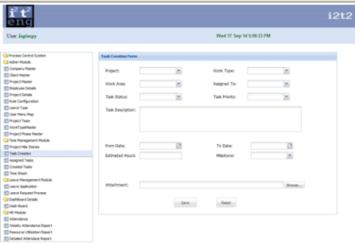
Process Controlling System
Opportunity
Product to manage all resources and their use in the entire enterprise in a coordinated manner.
Maintaining company and client details.
Maintaining employee records
Project details.
Other modules.
Technologies Used
Java 1.6, Struts 1.2, Extjs 4.0, Spring 3.0, Hibernate 3.0
Tomcat 7.0, Glassfish v3
MySQL 5.1.5
Benefits
PCS gives an easy interface to manage and organize all organizational activities .
Maintains companies and clients master
Maintains Employees records, Time sheet management & Leave management
Maintains all projects data and details.
HR Module
Day to day / timely updation of data from different departments and showcasing it in various reports such as bar graphs, pic charts, line graphs etc.

Slide 33
Arrears Calculation
Arrears Calculation is a software developed for HFCL – Hindustan Fluoro Carbons Ltd.
Technical Specifications:
Technologies: Asp.net, C#.net, Ajax Extensions, Crystal Reports, WCF
Database: Oracle 11g
Server: Windows 2003 Server
Highlights:
  One Click Processing, For Arrears Calculation
  Comprehensive Data Of Arrears between Different Durations of Employment.

Slide 34
ERP - HFCL
Hindustan Fluorocarbons Limited is a public section Central government Company .
Hindustan Fluorocarbons Limited (HFL) the first and only manufacturer of Poly tetrafluoroethylene (PTFE) - an Engineering plastic in India with know how from AOCHEM, France.
The major features of the Marketing Module includes Sales, Inventory Management, Treasury and Payroll Management.
Technical Specifications:
Technologies: Asp.net, C#.net, Ajax Extensions, Crystal Reports, WCF
Database: Oracle 11g
Server: Windows 2003 Server
Highlights:
  Cost Sheet maintenance
  Ledger Maintenance
  Balance Sheet
  User Level Access Control
  Data Storage, Back Up and Restore
  In Compliance to ISMS Standards
  High Level Data Encryption
  ISO 27001 Security Compliance
  Affordability, Flexibility And Localization

Slide 35
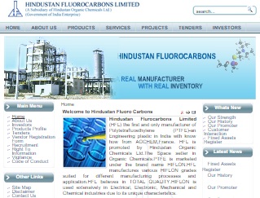
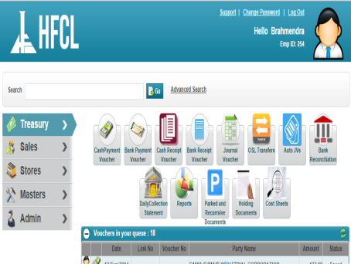
ERP - HFL
Opportunity
Tool which manages the required ERP – Modules such as
  Sales
  Inventory Management
  Treasury
  Payroll Management
  Admin
Technologies Used
Asp.net, C#.net, Ajax Extensions, Crystal Reports, WCF
Windows 2003 Server
Oracle 11g
Benefits
This Financial Package enables all the Treasury-modules in HFCL.
Marketing Module with Sales Package
Inventory & Stock Management
Treasury & Payroll Management
Day to day / timely reports showcasing in various formats such as bar graphs, pic charts, line graphs etc.

Slide 36
STAFFING PORTAL
Staffing Portal is a complete web-based software platform for the staffing and recruiting industry. It Has fully Integrated Front Office, Back Office and Intra Office with the facility of access and work remotely from any location.
      Consultant
      Companies
      Vendors
      Job Postings
      e-Campaigns
  Technologies Used
      JDK1.6, Hibernate 3.5, JSF 2.1, Glassfish 3.x, Primefaces 4.0, Spring 3.0
      Net Beans 7.0
      MySql 5.5
CRM MODULE

Slide 37
PAY ROLL
Payroll refers to the total amount of money that a company pays to its employees. The administration of the financial record of employees' salaries, wages, bonuses, net pay, and deductions. We can add delete and update employee details , define holidays, Leaves. Process the leaves applied by the employees to concerned authority..etc.
Technical Specifications:
Technologies: .Net 3.5, Asp.net, IIS 7.0, Crystal Reports
Database: MySQL 5.0
Server: Windows 2008 Server
Highlights:
  Add, Delete, update Employee
  Leaves Management
  Holidays Management
  Reports ..etc.

Slide 38
Project Management Tool
Project management is the discipline of initiating, planning, executing, controlling, and closing the work of a team to achieve specific goals and meet specific success criteria.
Managing and monitoring all the available internal projects of APUFIDC and tracking them periodically and maintaining the finance releases by GOI and GOAP.
Technical Specifications:
Technologies: Java 8.0, JSF 2.2, Spring 4.0.1, Hibernate 4.3,Reports
Database: MySQL 5.1
Server: Windows 2008 Server
Highlights:
  Project Entry at ULB levels.
  Finance Module
  Project Status tracking
  Reports

Slide 39
Online Survey (Praja Pratispandana)
A field of applied statistics, methodology to survey the sampling of individual units from citizens and the associated survey data collection such as questionnaire, construction and methods for improving the number and accuracy of responses to surveys.
Technical Specifications:
Technologies: Andriod, Java, .Net 4.0, Asp.net, IIS 7.0, Crystal Reports
Database: MySQL 5.1
Server: Windows 2008 Server
Highlights:
  Location tracing with GPS
  Offline Data capturing
  Online Sync (data) to server
  Reports ..etc.

Slide 40
Property Assessment
An assessor is a specialist who calculates the value of property. The value calculated by the assessor is then approved by Government official, used as the basis for determining the amounts to be paid or assessed for tax.
Technical Specifications:
Technologies: Andriod, Java 8.0, JSF 2.2, Spring 4.0.1, Hibernate 4.3,Reports
Database: MySQL 5.1
Server: Windows 2008 Server
Highlights:
  Assessment of available properties
  Location tracing with GPS
  Offline Data capturing
  Online Sync (data) to server
  Reports ..etc.

Slide 41
Feed Back Survey
A field of applied statistics, methodology to survey the sampling of individual units from citizens and the associated survey data collection such as questionnaire, construction and methods for improving the number and accuracy of responses to surveys.
Technical Specifications:
Technologies: Andriod, Java
Database: MySQL 5.1
Server: Windows 2008 Server
Highlights:
  Admin Questionnaire Entry
  Location based survey
  Location tracing with GPS
  Online Data capturing
  Online Sync (data) to server
  Reports ..etc.

Slide 42
Swasthya Vidya Vahini (SVV)
Swasthya Vidya Vahini is a unique initiative by the Government of Andhra Pradesh in the Medical Domain. It is a 10-month pilot project under which 32,000 students of medicine, nursing, psychology and home science will prepare disease profiles of villages by camping there on a daily basis.
The information compiled by them will be used for proper implementation of the schemes of the Medical, Health and Family Welfare Department and take up new ones with prevention (of diseases) as the focus, rather than persisting with the curative approach the outcomes of which are limited.
Technical Specifications:
Technologies: Andriod, .Net
Database: SQL server
Server: Windows 2008 Server
Highlights:
  Admin Dashboard to monitor the daily progress
  Android application for the students to input the data
  Web application to prepare schedule for students’ visit
  Location based survey
  Reports ..etc.

Slide 43
Business Opportunities Optimization Software (BOOM)
Business Opportunities Optimization Software is an Information Security Management Software developed mainly to cater to the security needs of small and medium scale companies.
Technical Specifications:
Technologies: Java, IDE: NetBeans 8.0.2/8.1, Hibernate:4.3.1, Spring:4.0.1
Database: MySql:5.1
Server: Apache Tomcat Server 8.0.15
Highlights:
  Client Creation by super admin (BOOM Admin)
  Flexibility increasing the scope for client for other branches
  Dashboard reports reflecting risk levels for each and all braches
  Confidentiality, Integrity and Availability (CIA) assessment and audit

Slide 44
Thank You

